Slide 1
Company Profile

Slide 2
Icon Electromatic Private Limited
Icon Electromatic - Fulfilment partners for your electronic ambitions
Icon Electromatic was started in 2009 in Bengaluru, India by skilled engineers with decades of experience in RF, Microwave, Semiconductors and Service Industries and expanded as Icon Electromatic Private Limited in 2020, extended their presence to other cities in India, Israel, Singapore, and USA. With our expertise and understanding of the ecosystems in Electronic Research, Development and Manufacturing in Aerospace & Defence, Hi Rel Space, 5G, SATCOM, Homeland Security and Smart City industries, be it in public or private sector, and with years of strong collaborations with manufactures worldwide, we engage not only in supplying the most advanced components from global leaders, but also in providing business consultancy and RF design services to enable Bespoke Solutions for our clients.
Vision
To become India’s largest and most reliable provider of electronics building blocks for R & D and Manufacturing companies/institutions in public and private sector.
Mission
To bring world’s most advanced technology solutions and components to India through symbiotic relationships with the world leaders in the field and thereby support indigenous product development and ‘Make in India’ initiatives.
Quick Facts
1500+ Products
150+ Collective Years of Experience
15+ Global OEM/Manufacturer Partnerships
•
•

Slide 3
Industries We Serve
We provide cost and time effective Electronic /Microwave/RF components, building blocks and subsystems for
5G
5G radio solutions for Telecom /Mobility /IOT needs
Aerospace & Defence
Avionics
RADAR’s
Military Communications
Electronic Warfare
Homeland Security
Perimeter Intruder Systems and Subsystems
Hi Rel Space
Hi Rel Microwave/RF components for
Space and Airborne applications.
Smart City
Project Consultancy and Building Blocks
SATCOM
MF/RF Components and Subarrays
Manufacturing Sector
Electronics side of manufacturing – PCBs and Component sourcing
Automotive
Healthcare

Slide 4
Services We Offer
We represent major RF, Microwave, mmWave, Semiconductors, Components,
Representation
of Global OEM’s
Subsystems and Power supplies manufacturers around the world, providing unparalleled support to electronic designers, manufacturers, engineers and researchers.
Product Supply and Logistics
With our expertise and understanding of the ecosystems in Electronic Research, Development and Manufacturing Industry, be it in public or private sector, and with years of strong collaborations with manufactures worldwide, we can suggest the most apt products to fulfil your designs
Design and FAB Assistance
We work in collaboration with reputed design and PCB fabrication houses in Europe/Asia, to provide individualised and customised services, catering to the requirements of various industries, ranging from basic to complex needs.
Icon Electromatic's leadership collectively carries centuries of professional expertise in various business domains. We further stretches it through meaningful partnerships with Global Leaders. We help organisations for Digital Transformation, Work From Home solutions, next generation Business Process Outsourcing, Make in India initiatives and many more.
Business Consultancy

Slide 5
Partners We Work With

Slide 6
Major Customers – A&D

Slide 7
Major Customers – Academic/Telecom/EMS

Slide 8
Presence and Contacts
Icon Electromatic Private Limited # 303/2, 5th ‘A’ Cross, HRBR Layout 3rd Block Kalyan Nagar, Banaswadi Bangalore – 560043.
Icon Electromatic Singapore Private Limited 71 UBI Road 1, #10-43, Oxley Bizhub
Singapore 408732.
Vedanga Ltd. Eizenberg 15/8 Rehovot 7629004
Icon Electromatic LLC 15412 Meadow Vista Drive Edmond, OK 73013
To Be Operational Soon

Slide 9
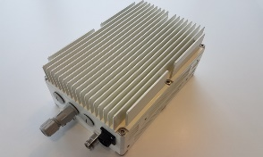
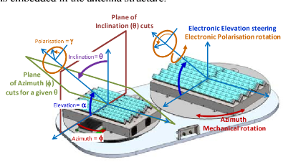
ENABLER OF MAKE IN INDIA
Icon Electromatic can play as a catalyst in advancing the Make in India ecosystem, particularly within the RF & MW sector.
OEMs
INDIAN ECOSYSTEM
Phased Array Radar
5G Radio
AWCS
SATCOM PHASED ARRAY ANTENA

